Slide 1

Protected Health Information and APCD Security
Spyridon Ganas

Slide 2
What is PHI?
Wikipedia defines Protected Health Information (PHI) as “any information about health status, provision of health care, or payment for health care” that “can be linked to a specific individual.”
PHI can include:
Medical records
Insurance company bills
Referral and prior authorization documents
Medical test results
Unauthorized release of PHI can lead to fines of up to $50,000 per incident.

Slide 3
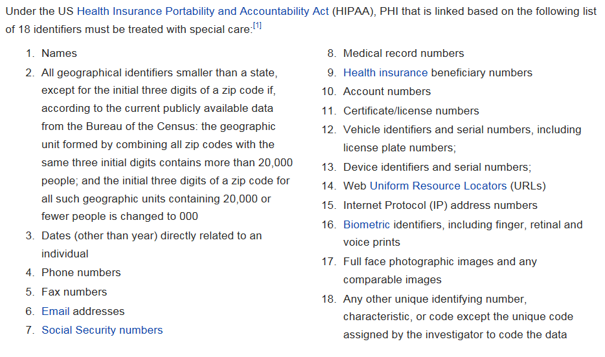
PHI Identifiers

Slide 4
PHI in the APCD
Date elements containing PHI identifiers are encrypted in the APCD
CHIA classifies data elements based on the data’s security risk:
Level 1 – Public Use
Level 2 – Restricted; Available to Government Agencies, Providers, Payer, Researchers and Qualified Individuals following approval by the Data Privacy Committee.
Level 3 – No Release; Available to Government Agencies, Providers, Payer following approval by the Data Privacy Committee.

Slide 5
Limited Data Sets
Limited Data Sets (LDS) are a subset of APCD data that were designed to exclude PHI identifiers.
LDSes have been pre-approved for release to researchers
When a researcher requests only LDS data, their request is fast-tracked and they are able to avoid the full data privacy committee review.

Slide 6
Social Security Numbers
Columns containing Social Security numbers and other highly sensitive data are encrypted.
Unencrypted columns might accidentally contain Social Security numbers.
Social Security numbers can show up in many different columns in the APCD. For example, they may appear as the medical record number, the Patient ID or the Provider ID.
Regular expression pattern matching code is used to search for any values that could possibly be Social Security numbers.
Those values are then redacted to insure that Social Security numbers are not accidentally release.

Slide 7
References
https://en.wikipedia.org/wiki/Protected_health_information
http://www.ama-assn.org/ama/pub/physician-resources/solutions-managing-your-practice/coding-billing-insurance/hipaahealth-insurance-portability-accountability-act/hipaa-violations-enforcement.page
http://www.chiamass.gov/privacy-program/
http://www.chiamass.gov/assets/docs/p/apcd/release1/data-release-regulation-957-5.pdf

